Slide 1
1

Slide 2

The WissKI project:
collections of the
University Erlangen-Nuremberg
wisski.cs.fau.de/sammlungen
wisski.cs.fau.de/sammlungen/tutorials
Dr. Mathias Rösch
19. Mai 2015
Schulmuseum Nürnberg

Slide 3
I want to talk about ...
The Collections of University Erlangen-Nuremberg
Their every day use
Their recording status
Why WissKI? Our expectations
Proceedings of the WissKI project

Slide 4
1. University Collections
German universities usually have collections
Some used for research and teaching
Sometimes a collection is also a museum
University Erlangen-Nürnberg has 23 collections
Medicin, Biology, Mathematics etc.
two of them are public museum:
School Museum and the Classical Collection

Slide 5
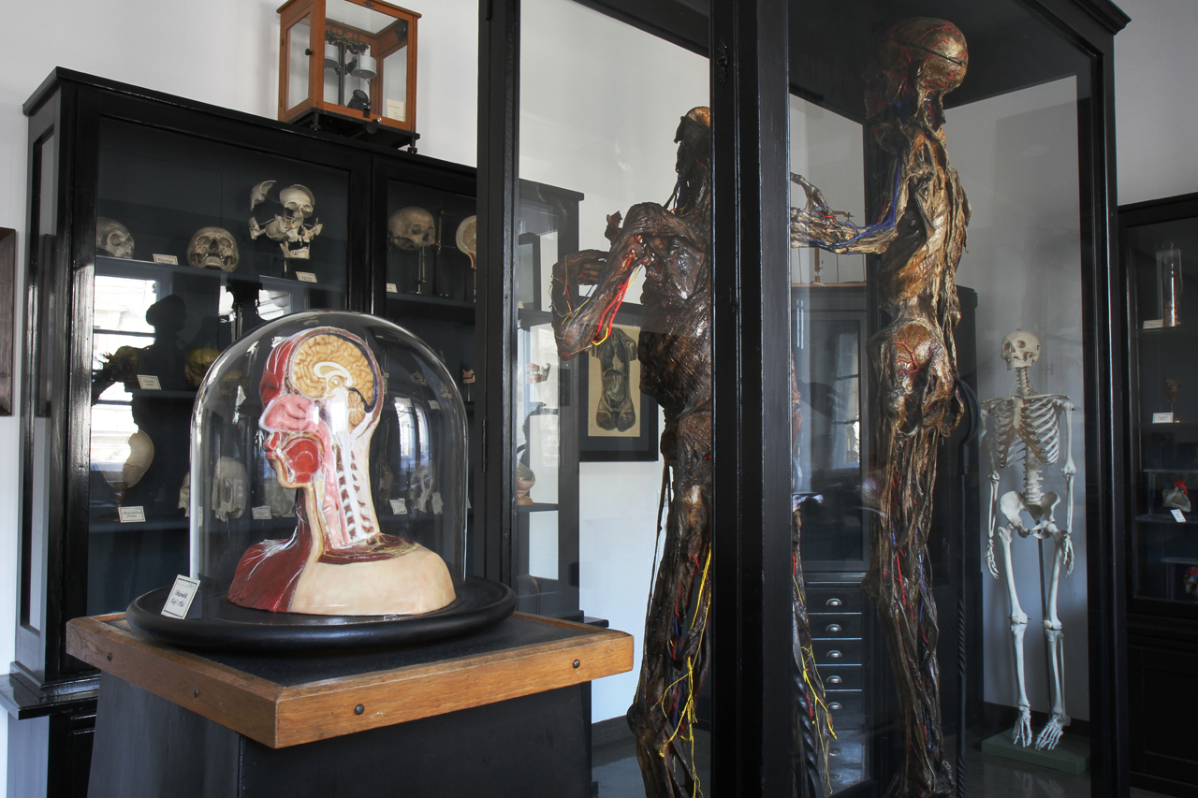
Anatomical Sammlung

Slide 6
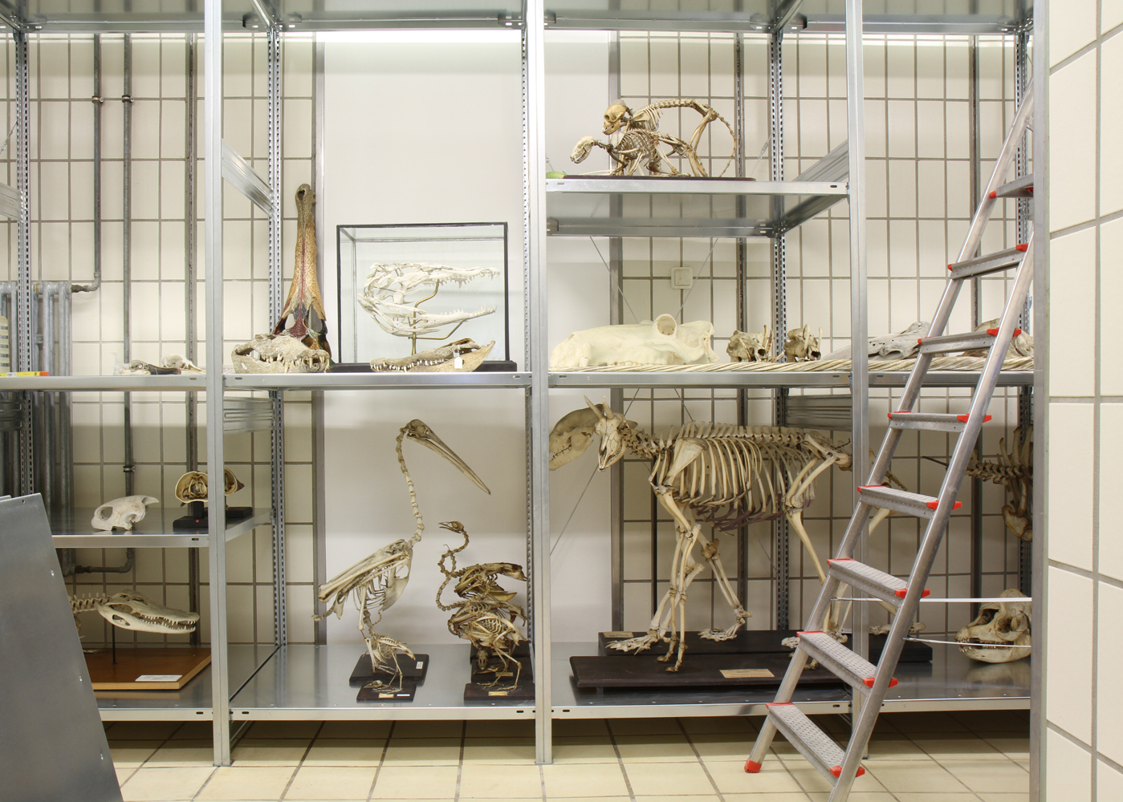
Zoological collection

Slide 7
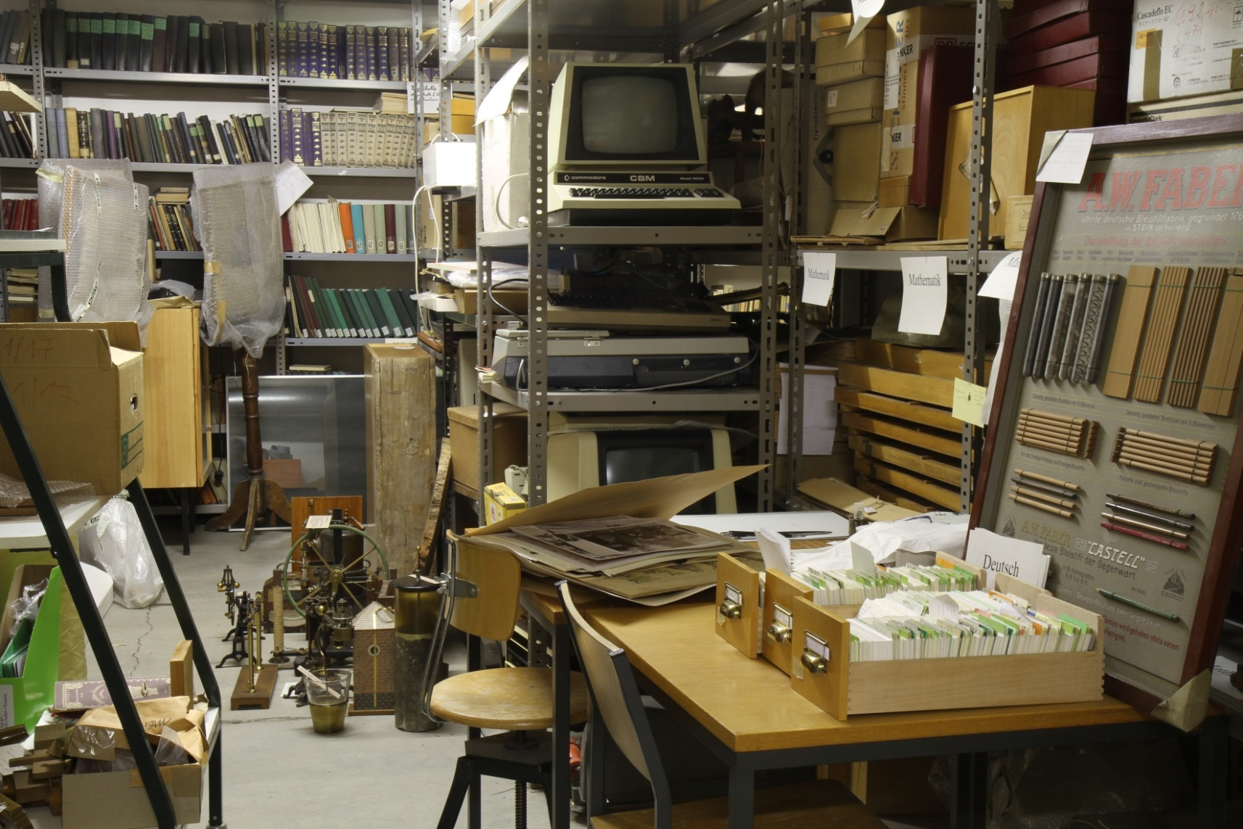
collection of school history: one of three depots

Slide 8
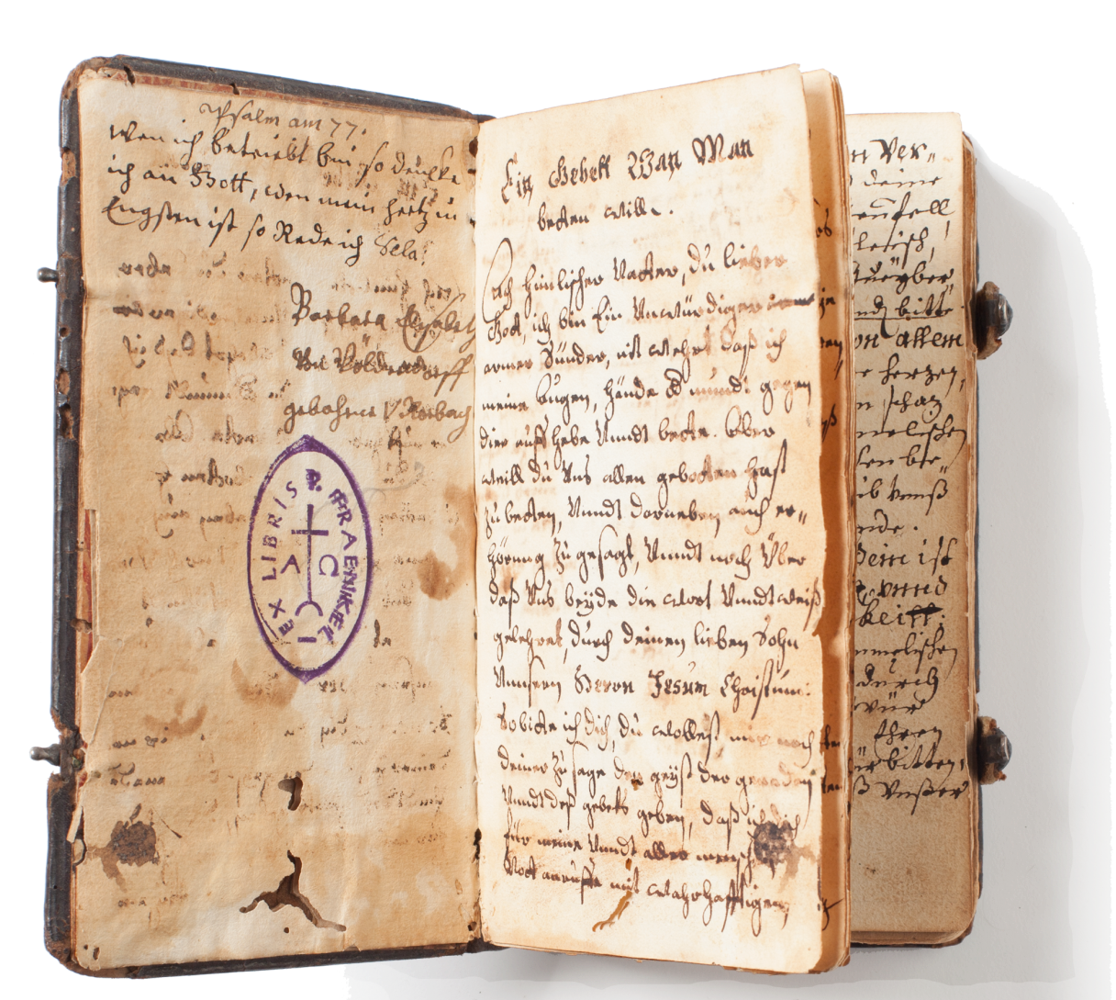
collection of school history:
40.000 books

Slide 9
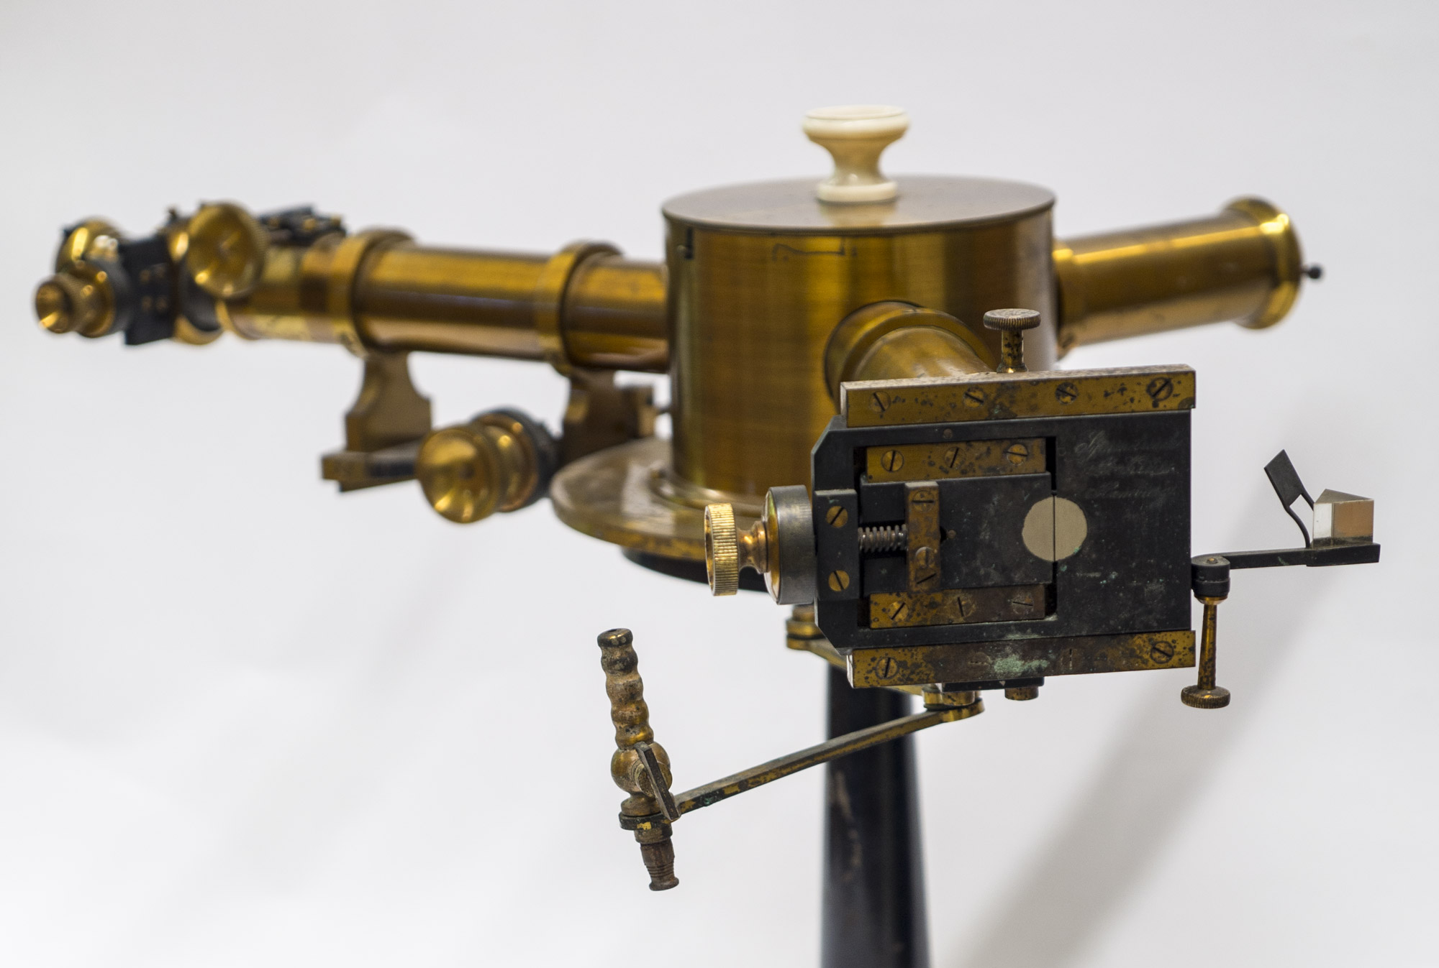
collection of school history:
140.000 objects

Slide 10
Die Sammlungen der FAU
Anatomische Sammlungen
Antikensammlung
Astronomische Sammlung
Botanische Sammlungen
Ethnographische Sammlungen
Geowissenschaftliche Sammlungen
Informatik-Sammlung
Martius-Pharmakognosie-Sammlung
Mathematische Modellsammlung
Medizinische Sammlung
Moulagensammlung
Musikinstrumenten-Sammlung
Pathologische Sammlung
Schulgeschichtliche Sammlung
Sammlungen im Universitätsarchiv
Sammlungen in der Universitätsbibliothek
Ur- und Frühgeschichtliche Sammlung
Zoologische Sammlung

Slide 11
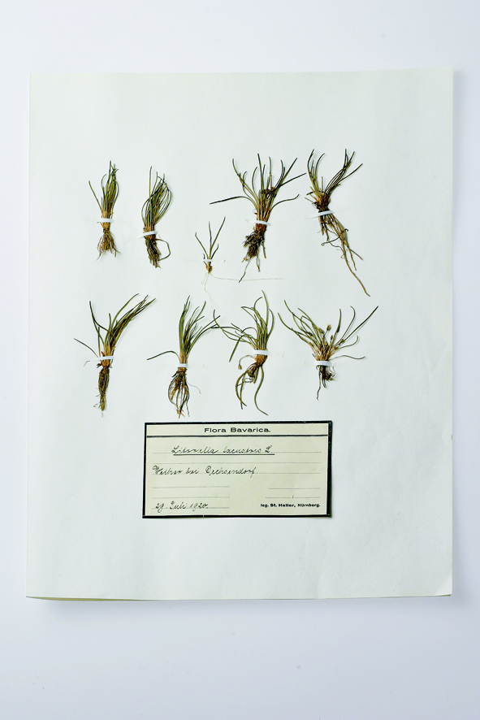
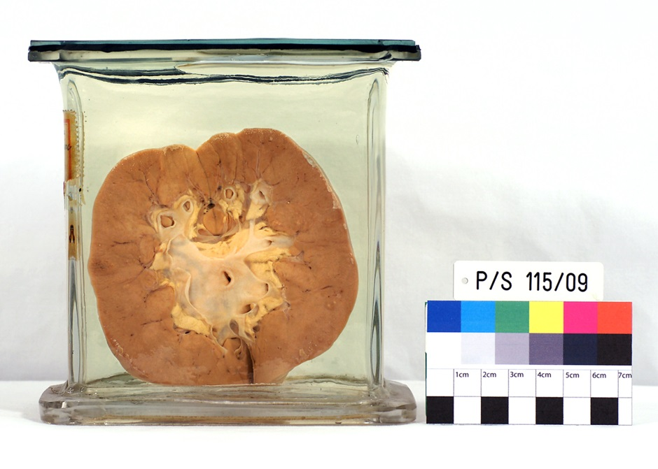
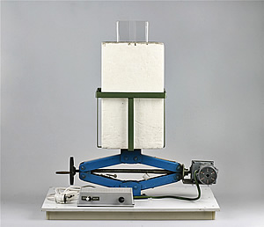
Human substance
plants
Technikal equipment
Diversity of objekts

Slide 12
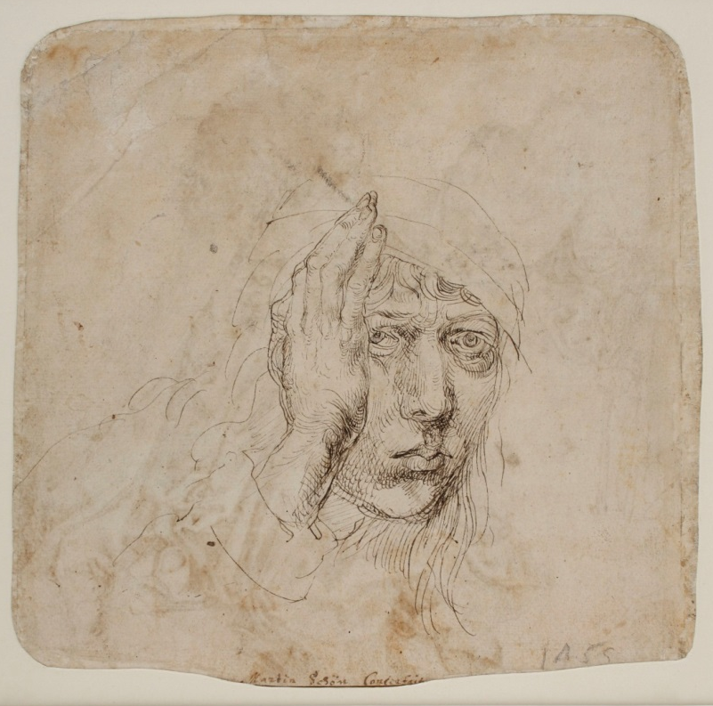
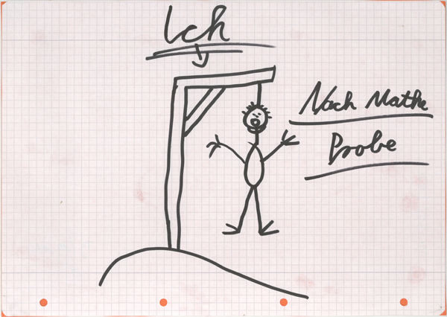
art
illegal letters of pupils

Slide 13
Diversity of these Collections
Each collection has its own history
Connection to their department / discipline
Different software tools, states of digitalisation and web presence
Different metadata models

Slide 14
2. Their Every day use
Research
teaching at University
public relations / museum
= cultural heritage and actively use: Objects offers historical evidence
Efforts of the common collection management: strengthen recording, conservation and the public use

Slide 15
3. The recording status
less of these collections have recorded their complete stock
most of them just got 30 or 50 percent recorded by PC
some of them just got recorded by paper-index-cards

Slide 16
4. Expectations on WissKI
Two main benefits:
We get a secure database for international academic communication
The Project is a chance to find and establish common structures for all the different Erlangen-Nuremberg collections

Slide 17
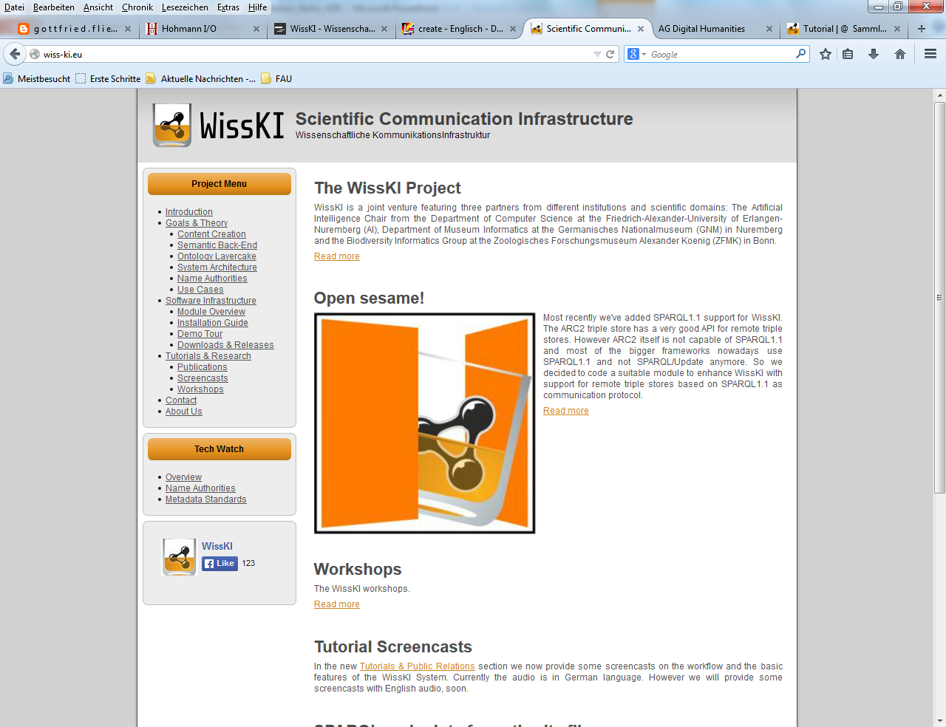

Slide 18
Pilot project with 3 collections
Computer Science Collection
Herbarium Erlangense
School Museum
Started in late 2013
Regular workshops
No funding (1 student assistant)

Slide 19
Measures and targets of the project
Explore the use of WissKI and CIDOC CRM for the collections
Compile a “how-to” for other collections
Survey the development status of all collections
Digital strategy for all collections
Consolidation of existing databases
Standardise acquisition and develop stocks
Develop a common online portal of all University collections

Slide 20
6. The proceeding of the project
Done so far:
Familiarize with WissKI & Ontologies
Identify commonalities & differences in the data and schemas
Create / extend domain ontology
Define and model forms and fields
Import data from legacy databases

Slide 21
Still to be done
Import data from legacy databases
Test and correct: the manually revising low quality data
Use name authorities / controlled vocabularies or publish own ones
One public interface to the collections
Search and browse all three collections at once
Interlinked collections

