Slide 1
Tracking Marine Fauna
Some (real) examples
Yannis Marketakis

Slide 2
ProDelphinus Peru Leatherback Tracking Project
Pro Delphinus is committed to the conservation threatened and endangered marine fauna.
Such as sea turtles, marine otters, cetaceans, seabirds and sharks
Pro Delphinus uses the Darwin Core Archive format (DwC-A, https://en.wikipedia.org/wiki/Darwin_Core_Archive)
We present here the mapping of Pro Delphinus DwC-A to “Marine TLO”
“Marine TLO (Top Level Ontology)” is a CRM compatible Ontology, which has been developed by a team of biologists under the lead of ICS-FORTH as knowledge engineers, in the framework of the iMarine Project (http://www.i-marine.eu, a consortium of over 40 partners) and been accepted by the involved professionals and been employed in this Project (Partially “Marine TLO” has renamed existing CRM concepts in order to make them comprehensible and acceptable to the biodiversity scientific community).
Currently, Marine TLO is used by LifeWatchGreece, i.e., the national Greek biodiversity infrastructure and the European H2020 BlueCloud project.

Slide 3
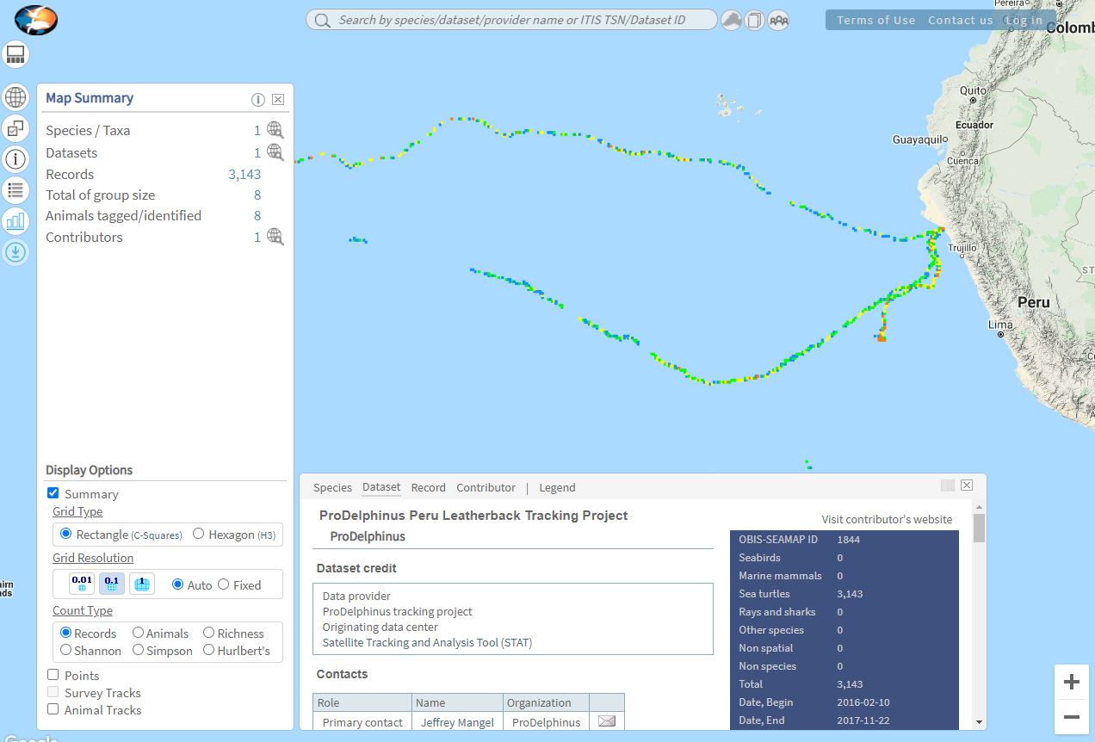
Tracking Leatherback Sea Turtles (8 instances) (https://seamap.env.duke.edu/dataset/1844)

Slide 4
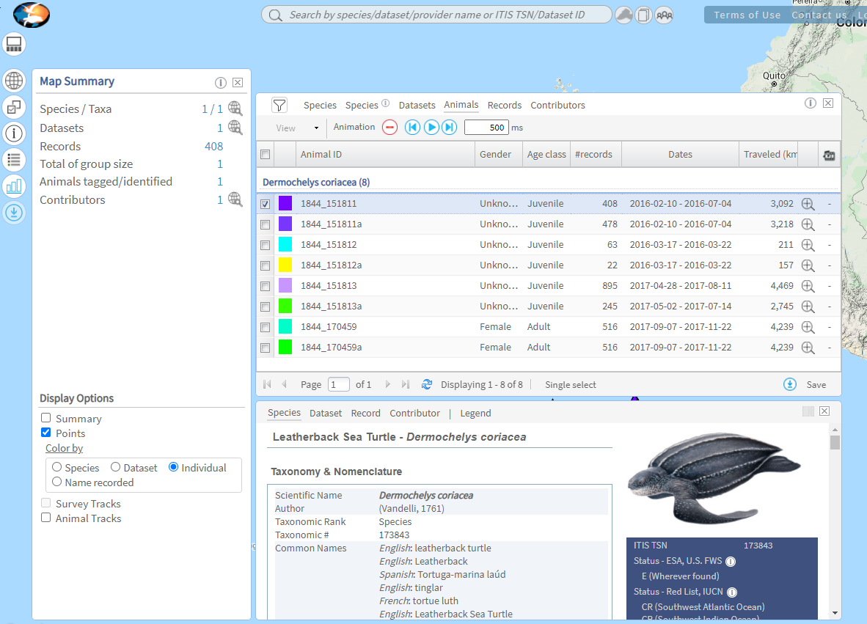
Tracking Leatherback Sea Turtles (8 instances) (https://seamap.env.duke.edu/dataset/1844)
Each instance with its own identifier

Slide 5
Tracking Leatherback Sea Turtles (8 instances) (https://seamap.env.duke.edu/dataset/1844)
The occurrence dataset is available in DwC-A from OBIS and GBIF
https://obis.org/dataset/e3c359b0-ac7f-4360-a788-6e19e286d155
https://www.gbif.org/dataset/3911abad-cec0-4ac3-af06-071bc2cf0765

Slide 6
Tracking Leatherback Sea Turtles (8 instances) (https://seamap.env.duke.edu/dataset/1844)
A part of the occurrence dataset of the DwC-A
identifier | datasetID | datasetName | occurrenceID | OrganismID | eventDate | decimalLatitude | decimalLongitude | scientificNameID
3086551393 | 1844 | ProDelphinus Peru Leatherback Tracking Project | 1844_909749 | 170459 | 2017-11-08 T18:23:55 | -3.5 | -108.5 | urn:lsid:marinespecies.org:taxname:137209
3086551392 | 1844 | ProDelphinus Peru Leatherback Tracking Project | 1844_909827 | 170459 | 2017-11-20 T17:23:21 | -3.5 | -113.5 | urn:lsid:marinespecies.org:taxname:137209
3086551391 | 1844 | ProDelphinus Peru Leatherback Tracking Project | 1844_759257 | 151811 | 2016-02-28 T13:42:17 | -11.5 | -83.5 | urn:lsid:marinespecies.org:taxname:137209
3086551390 | 1844 | ProDelphinus Peru Leatherback Tracking Project | 1844_909709 | 170459 | 2017-10-30 T17:50:36 | -1.5 | -105.5 | urn:lsid:marinespecies.org:taxname:137209
3086551389 | 1844 | ProDelphinus Peru Leatherback Tracking Project | 1844_759336 | 151811 | 2016-03-10 T08:22:28 | -12.5 | -82.5 | urn:lsid:marinespecies.org:taxname:137209
Instance 1
Instance 2

Slide 7
Tracking Leatherback Sea Turtles CRM Modeling (a part of)
E52 Time-Span 2017-11-20 T17:23:21
P4 has timespan
S19 Encounter Event 3086551392
S19 Encounter Event 3086551393
P4 has timespan
E52 Time-Span 2017-11-08 T18:23:55
P7 took place at
P7 took place at
P10 falls
within
E53 Place
LC27 has
section
BC14 Ecosystem Environment
BC14 Ecosystem Environment
E53 Place
P87 is identified by
P87 is identified by
O32 has found object
E47 Spatial Coordinates
-3.5, -108.5
E47 Spatial Coordinates
-3.5, -113.5
BC38 Biotic Element
1844_170459
belongs to
E42 Identifier urn:lsid:marinespecies.org:
taxname:137209
BT27 Species Dermochelys coriacea
BT26 Genus Dermochelys
BT24 Family Dermochelyidae
BT34 Order Testudines
BT22 Class Reptilia
BT18 Kingdom Animalia
belongs to
belongs to
belongs to
belongs to
belongs to
P1 is identified by

Slide 8
References
The scope notes of BC14 can be found in https://projects.ics.forth.gr/isl/ontology/content-MTLO/html/BC14_Ecosystem_Environment.html. It connects E53 Place via LC27.
The hierarchical position of BC38 can be found in https://projects.ics.forth.gr/isl/ontology/content-MTLO/html/BC38_Biotic_Element.html
Marine TLO
Y. Tzitzikas, C. Alloca, C. Bekiari, Y. Marketakis, P. Fafalios, M. Doerr, N. Minadakis, T. Patkos and L. Candela Unifying heterogeneous and distributed information about marine species through the top level ontology MarineTLO, Program: Electronic library and Information Systems, Special Issue on Application of Metadata and Semantics in Science, Vol. 50, No. 01 (2016), Emerald (ISSN: 0033-0337).
For further references see: https://projects.ics.forth.gr/isl/MarineTLO/

