Slide 1
Towards a CRM for archaeological field walking surveys
Introductory presentation
Martijn van Leusen, University of Groningen Institute of Archaeology, dept. Of classical and mediterranean archaeology
CRM Special Interest Group meeting, Prato (IT), Feb 24-26, 2016
Notes:
Martin and Chryssoula, thank you for allowing me to present the relevant part of my current research here.
As you see from my title, this work would have been better placed in yesterday’s program, but unfortunately I was not able to arrange an earlier flight to Prato....

Slide 2
Background
Active in developing fieldwalking methodology since mid-1990s (Wroxeter Hinterland Project) but especially since 1998 (RPC Project surveys in central and southern Italy)
Background in GIS and Landscape Archaeology
Lurking in FISH circles to keep informed about knowledge organization systems; building a thesaurus app for describing archaeological web content within the INCO-COPERNICUS program
Responsible for several large research projects involving post-doc and PhD researchers; documentation and archiving requirements not yet adequately addressed
Founding member of IMSW (international mediterranean survey workshop series)
Notes:
Let me very briefly sketch my background for you. I am a landscape archaeologist mainly interested in improving our methodology for noninvasive landscape-scale studies. Field walking survey is one of the main methods available to us. IMSW meets twice a year since 2001, brings together many resesearchers and students interested in Mediterranean survey practice and methodology.
Already in the late 1990s, while still working in England, it became clear that building controlled vocabularies was an important step in bringing sense to a ‘wild west’ of documentation practices, and making archaeological data searchable in a reliable and predictable way. At first this involved only vocabularies and thesauri, but under the influence of the IMSW desire to compare or even merge survey data produced by different projects the need for a much more powerful tool became evident. Via my participation in CAA I already knew of the CIDOC-CRM activities, especially by Steve Stead, and was able to contact this SIG.

Slide 3
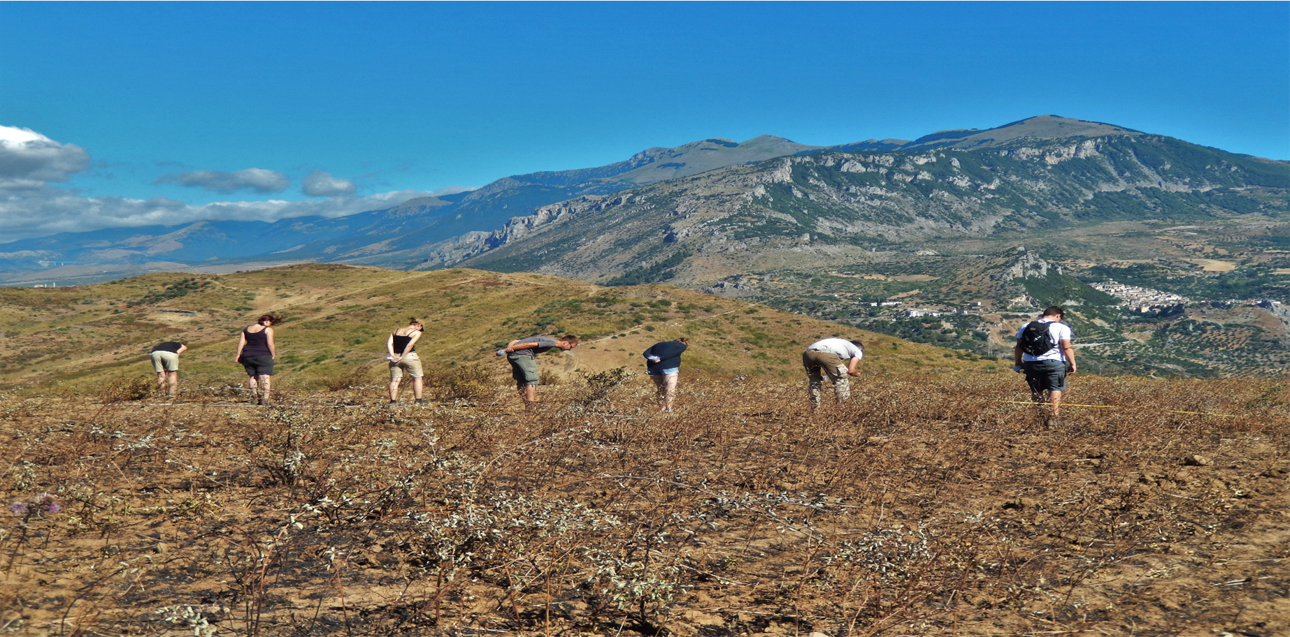
Field Walking Surveys
Approach used since 1930s
Boost in the late 1950s (TVP) and very popular in NW-Europe in the 1960s and 1970s
Continuous interest in Italy since Barker’s Biferno Valley survey of the early 1980s
Methodological weaknesses recognised but often not addressed

Slide 4
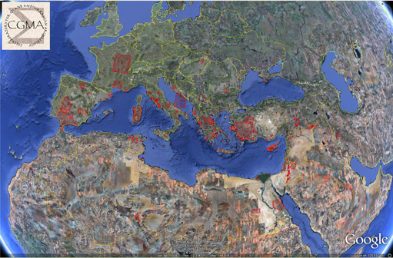
Current Work
Integrating three regional survey databases from central Lazio - the Pontine Region Project, the Tiber Valley Project and the Suburbium Project – meetings in September & December 2015
IMSW board initiative: Field Survey Guide to Good Practice – requires developing a dictionary/thesaurus and addressing CRM
Archiving the Hidden Landscapes, Rural Life and Minor Centers projects (2005-2015) at DANS according to NWO requirements
http://cgma.depauw.edu/MAGIS/Help/help.php#spatial_map
Notes:
There are now three reasons why I wanted to be present here and apply for a membership in the CRM-SIG.
First is a recently started project aiming to merge three independently produced regional survey databases (named here) in order tro explore supraregional patterns and intraregional variations. In its most recent meeting I advocated the CRM approach so that all three might be mapped to a common model, in the expectation that a successful implementation would allow any number of other survey databases to be mapped and made searchable in the same manner.
Second since 2001 an international group of mediterranean survey archaeologists has met twice a year to discuss common concerns; among these is the need to formalize the description of what we do and the data we produce, for example by encouraging standardization via a G2GP. In this case, too, I believe that a fundamental step must be taken by designing a common CRM.
Third as an university employee I am not just responsible for running several large concurrent projects involving survey activities, but also for the correct generation, processing, storage, selection and archiving of archaeological data. The Dutch CNR requires that I do this, and the Dutch state requires that my data should be available for future researchers. Current practice falls far short of the ideal here; eg deposition with DANS is possible with very limited metadata, making it unlikely that another researcher can really re-use my data. Again I would like to explore ways forward in a pilot project subsidised by DANS, in which I and a colleugue demonstrate a CRM/mapping approach to deposit in a much richer manner.
[] MAGIS overview of survey projects (incomplete)
Meeting in Groningen on 7/8 sep 2015: startup meeting. Integrating regional survey databases around Rome: methodological challenges and interpretive potential. Initiators: Prof. dr. Peter Attema, Groningen Institute of Archaeology and dr. W. Jongman, Economic and Social History; Prof. dr Paolo Carafa, Sapienza Università di Roma, Facoltà Lettere e Filosofia, Rome; Prof. dr. Christopher Smith, director, The British School at Rome. Meeting in Rome on 18/19 December 2015: exploring the details, including the potential use of CRM. From my notes: Whilst the ‘mapping’ of three database structures onto one another is not yet too onerous a task, it very quickly does become so if and when we decide to add other survey databases as well. Therefore a theoretically more efficient solution would be to define a single conceptual reference model (CRM) for survey databases, and make a single mapping of each participating database to that CRM. I already briefly explored this together with Tymon de Haas, and we intend to continue investigating it in the next few months, hopefully with some funding from the Dutch Royal Academy of Sciences KNAW. If successful, such a CRM mapping would allow each database to be exported to an XML table that can be put on a central database server and be queried online. However, it should be noted that we know of no actual working example of archaeological databases that have been made accessible in this manner. Possibly we can run a pilot to test this mechanism with the help of the ARIADNE network.

Slide 5
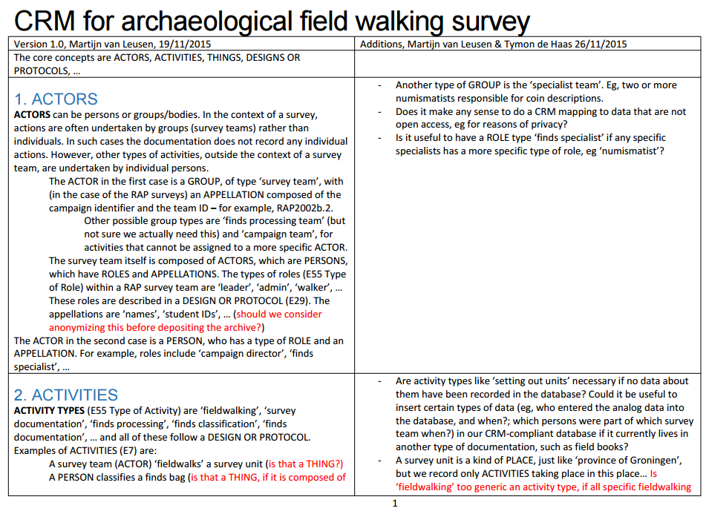
Groningen – The Hague - Prato
Draft CRM document Van Leusen/De Haas discussed with Steve Stead on 22 September 2015
KNAW/DANS ‘small data project’ approved early February 2016
Studying CRMarcheo and joining CRM-SIG
Notes:
1) Draft CRM document Van Leusen/De Haas v2, discussed with Steve Stead on 22 September 2015
2) KNAW/DANS ‘small data project’ approved early February 2016
3) Studying CRMarcheo and joining CRM-SIG
DANS/KNAW project goal: ‘het uitbreiden van het huidige ontwerp-CRM voor archeologisch veldonderzoek (CRMarchaeo) naar veldverkenningen/surveys en het ‘mappen’ hiervan op een drietal bestaande archeologische databases’. Doel van de aanvraag is om een drietal Groningse surveydatabases met uiteenlopende inhoud en structuur te ‘mappen’ op een nieuw te ontwerpen uitbreiding van het CIDOC-CRM (CRMarchaeo; Cripps et al. 2014) - en deze vervolgens inclusief mapping te deponeren bij DANS. Door het CRM vrij beschikbaar te stellen aan andere DANS-gebruikers verwachten wij dat de deponeringspraktijk verbetert en daadwerkelijk hergebruik van data hiermee aantrekkelijker wordt.
Indien deze pilot succesvol is zal de CRM-uitbreiding ook gebruikt worden binnen lopende samenwerkingsverbanden van het GIA: het ‘mappen’ van surveydatabases van internationale partners als de British School en de Sapienza Universiteit in Rome (Suburbium Project), en werk aan de definitie van Best Practice in het kader van het International Mediterranean Survey netwerk. Daarbij wordt, omdat DANS deze dienst nog niet aanbiedt, waar mogelijk aansluiting bij het ARIADNE initiatief gezocht om ervaring op te doen met het via LOD ontsluiten van de gedeponeerde data.
drie Groningse surveydatabases gebruikt die inhoudelijk zoveel mogelijk van elkaar verschillen. De in mei 2005 bij DANS gedeponeerde PRP fase 2-database bevat per vindplaats en veld georganiseerde gegevens (120 sites, 200 field records, 1500 transect records), de Lepini-database bevat aan geopunten en -lijnen gerelateerde data (30 units, 30 tracks, 50 puntwaaremingen, 90 sites), en de Minor Centres-database bevat naast gridded data veel aardewerkgegevens (5000 grid records, 30.000 artefact records). Omdat deze databases ouder onderzoek incorporeren en over een langere periode gevormd zijn (1994-2015) verwachten we de CRM-extensie ook geschikt te kunnen maken voor legacy data.
Fase 1: Vooronderzoek en CRM-ontwerp; start 1 april - eind 30 mei 2016. Postdoc en assistent besteden in deze fase de helft van hun aanstelling.
Fase 2: Mapping, conversie en documentatie van de pilot databases. 1 juni – 30 september. Wetenschappelijke presentatie in september.
Fase 3: Deponering en eindrapportage. 1-15 oktober.

Slide 6
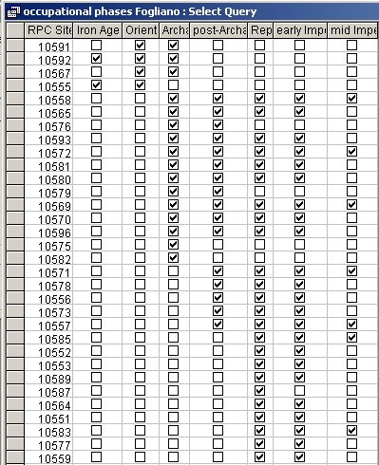
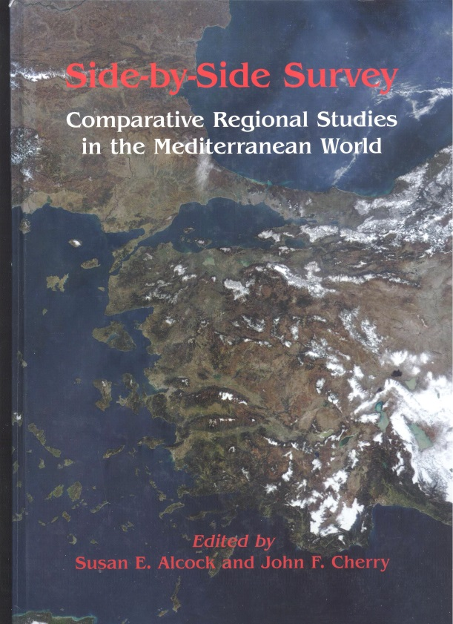
IMSW Aims and goals
Establish minimal quality standards
Provide an aid to young researchers
Ensure comparability of documentation
Notes:
What are our aims and goals of such an article?
First of all, as we know from our workshops many researchers experiment with methods, this is indicative of the vigour of the discipline, but it also means that there is no consensus on what constitutes good practice. The International Mediterranean Survey Workshop is the appropriate forum to arrive at a certain degree of consensus: we need to show that we are able to agree on what constitutes ‘good practice’ , i.e we should be able to establish minimal quality standards, or even ‘best practice’. For example, we agree that the registration of potential bias factors (more than just vegetation cover) is a necessary element of field documentation. However, we do not yet agree on which factors should be recorded, at which spatial and measurement scale they should be recorded, and how we can be objective about this.
As far as the second point is concerned, it should not be necessary for young researchers to ‘reinvent the wheel’ or to make the same mistakes that the senior surveyeors amongst us all made 20 years ago. Fieldwalking surveys are relatively cheap and normally not subject to long permission procedures, so this is an avenue open to young researchers to conduct good and relevant research – provided they can stick to defined best practice!
As far as point three is concerned, the need to exchange and compare survey data across projects and even countries seems extremely important to us. This requires that the documentation (often a database) comply with minimum requirements regarding quality control, metadata, and vocabulary control. The need for comparability has been covered by the Side-by-side volume (Alcock/Cherry 2004), but we want to reiterate here that answering any large-scale historical question on the basis of survey data absolutely requires that these data are, or can be made, comparable.
6

Slide 7
IMSW document outline
1 Introduction
1.1 Why survey?
1.2 Current state of the field & reasons for wanting a definition of best practice
1.3 Structure and scope of this article
2 Lessons From Current Practice
2.1 Approaches to the survey of regional landscapes
2.2 Sampling
2.3 Revisiting sites
2.4 Integration of surveys with other approaches to the archaeological landscape
3 Good Practice
3.1 Research design
3.2 Primary data collection/recording
3.3 Specialist finds studies and interpretative studies
3.4 Publication and archiving
Glossary
References
Notes:
Our current text was produced on the basis of the responses to John Bintliff’s and my emailed request to participants in the workshop to comment on certain issues. The responses were organized and edited by us into the current document, of which this is the proposed outline.
The article consists of three parts:
Introduction explaining the background and need for this document
Extensive discussion of arguments and examples underlying ‘good practice’.
Good practice itself
We found it immediately necessary to start a glossary to agree on a ‘controlled vocabulary’, because many terms are not defined or used in different ways by different people.
7

Slide 8
Section 2: Lessons From Current Practice
2.1 Approaches to the survey of regional landscapes
2.1.1 Off-site survey: sites, haloes and sherd carpets
2.1.2 Sites within sites
2.1.3 Survey of (large) complex sites
2.1.4 Survey of Multi-period sites
2.1.5 Survey of protohistoric early urban sites
2.1.6 survey of rural settlement
2.2 Sampling
2.2.1 Sampling landscapes
2.2.2 Sampling (in the field)
2.2.3 Site sampling
2.2.4 Sample size
2.2.5 Sampling bias
2.3 Revisiting sites
2.3.1 Revisiting your own sites
2.3.2 Revisiting other people’s sites / legacy sites
2.4 Integration of surveys with other approaches to the archaeological landscape
2.4.1 Remote Sensing
2.4.2 Geophysical survey
2.4.3 Geoarchaeological approaches
Notes:
Section 2 goes into our joint experiences with survey in different Mediterranean landscapes, from freshly ploughed fields to landscapes with extensive vegetation cover and from small dispersed artefact scatters to thick carpets of sherds. The first set of items touch on basic subjects as how to survey regional landscapes and how to survey specific types of sites ranging from ‘simple’ monophase rural sites to complex urban ones. The second set of items deals with sampling at different scales and in different contexts. The third set of items is about the importance of revisiting sites. The fourth set is on the integration of other landscape archaeological approaches.
8

Slide 9
CRMarchaeo 1.3 – questions and comments
Nearly all survey archaeology is happening at an A3 stratigraphic interface – namely, the current surface, but also in an A2 Volume Unit – namely, the plough layer. Are surface finds A7 Embedded in the plough layer?
Is this CRM ‘geologist proof’? They may have a different conceptualisation of the coring / excavation process and of stratigraphy…
Is the decision to designate a spatially coherent set of surface finds a ‘site’ an A6 Group Declaration Event?
AP2 discarded into: immediately on finding, a little later but still in the field, after finds processing, or after a deselection event?

Slide 10
Terminology: examples from the RAP surveys
Transect – a single 50m line, recorded in the GIS, uniquely numbered
Transect sample – collection made by a specified Walker on the specified Transect
  ‘standard’ or ST sample – collection made according to standard RAP protocol
  ‘slow’ sample – speed adapted to allow collection of all finds visible from transect line
  ‘total’ sample – sum of slow and standard samples for the same Transect

Slide 11
Should the CRM also be able to deal with instances of a type of thing? For example, an individual sherd as a type of ‘pottery class 2b’
Is the breaking of a pot into fragments, and the further fragmentation of those fragments by ploughing, an E6 Destruction or a transformation?
Etc.

Slide 12
Controlled vocabulary (glossary)
Halo, Off-site, Site, Transect, Complex site, Unit, walker interval, intensive/extensive, topographical
Example: what is a (site) halo? We propose: “area of higher-than-background finds density resulting from the ploughing out of a site”
  Need to define ‘background density’ and ‘site’ as well
  So what about the alternative definition, “area of finds relating to activities and deposits ocurring outside the inhabited buildings of a settlement”? We think this is more problematic because it requires an interpretation of the finds
  Can we connect with the existing ARIADNE (Advanced Research Infrastructure for Archaeological Dataset Networking ) European project? They have extensive experience with vocabularies and making databases comparable…
Notes:
In the texts submitted by you for the first version of this article, we encountered terms such as Halo, Off-site, Site, Transect, Complex site, Unit, walker interval, intensive/extensive, topographical. Precise definitions are lacking but from context it is clear that these terms have different meanings for different people. This needlessly complicates communication, comparability and, ultimately, standardization.
We therefore propose to construct a glossary of agreed terms and their meanings (a controlled vocabulary).
12

Slide 13
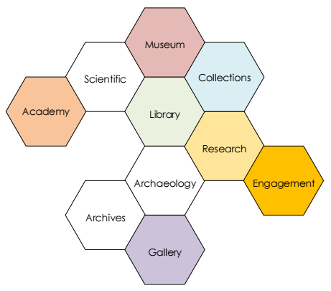
CRMarcheo
CRMsci
CRMinf
Conceptual Reference Models for Archaeological Fieldwork
General CRM tutorial: www.cidoc-crm.org/cidoc_tutorial/
Notes:
On a completely unrelated topic, we begin work on a CRM extension for archaeological field survey. We see this as a useful step not only in the work towards a definition of best practice (ref paper presented at Ankara by Attema), but also as a step towards being able to deposit our digital fieldwalking data as Linked Open Data. This CRM extension can build on recent initiatives to describe CRMs for archaeological excavation, for scientific observation, and for inferring things (all 2014-2015), and eventually on the CIDOC-CRM itself.
What is a CRM and why should we want one? A Conceptual Reference Model is an ontology. It describes, in a formal way, the concepts that we employ when we do (plan, execute, document, analyse, interpret) field survey. For example, rather than saying ‘MvL was leader of team 1 who surveyed unit 2032 on 6 Juli 2009’, we abstract this to say that field surveying involves various types of entities, such as Actors, who can be Persons, who have Appellations (such as names) and Roles (such as survey team leader). An Actor can perform diverse classes of Activities, such as FieldWalking or PotWashing, on another specific entity, such as ‘survey unit 2032’ or ‘finds bag 2032/01’. Etcetera.
“The primary role of the CRM is to serve as a basis for mediation of cultural heritage information and thereby provide the semantic 'glue' needed to transform todays disparate, localised information sources into a coherent and valuable global resource.”

Slide 14
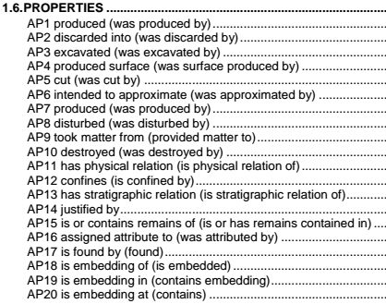
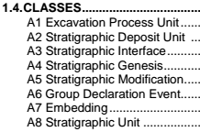
CRMarcheo
An extension of CIDOC-CRM to support archaeological excavations
Produced by FORTH and collaborators
Version 1.2 (draft), March 2014
Scope
Models: CIDOC-CRM, CRMsci, CRMinf
Notes:
It turns out that you do not need very many of these concepts in order to build an exhaustive model of your discipline: CRMarcheo gets away with 35 classes (most of which are referred from CRM and CRMsci) and 20 properties.
Of course each class and property is fully described (not shown here), and placed in a hierarchy so that its relation to any other class and property is clear. That’s where all of the thinking work has to be done!
Scope:
The goal of this model is to provide the means to document excavations in such a way that the following functionality is supported:
1. Maximize interpretation capability after excavation or to continue excavation
Reason of excavation (goals). What is the archaeological question?
2. Possibility of knowledge revision after excavation
3. Comparing previous excavations on same site (space)
4. All kinds of comprehensive statistical studies (“collective behavior”)
Models:
CRMarcheo refers to and reuses, wherever appropriate, constructs from ISO21127 (the CIDOC Conceptual Reference Model), together with their definitions following version 5.1.2 maintained by CIDOC. The complete definition of the CIDOC Conceptual Reference Model can be found in its official site: http://www.cidoc-crm.org/official_release_cidoc.html.
It also refers to and reuses, wherever appropriate, constructs from the Scientific Observation Model, CRMsci, together with their definitions following version 1.2 maintained by FORTH. The complete definition of CRMsci is available at
http://www.ics.forth.gr/isl/CRMext/CRMsci/
CRMinf is an extension of CIDOC-CRM to support argumentation, produced by Paveprime Ltd and collaborators (Version 0.76 (draft) February 2015).

Slide 15
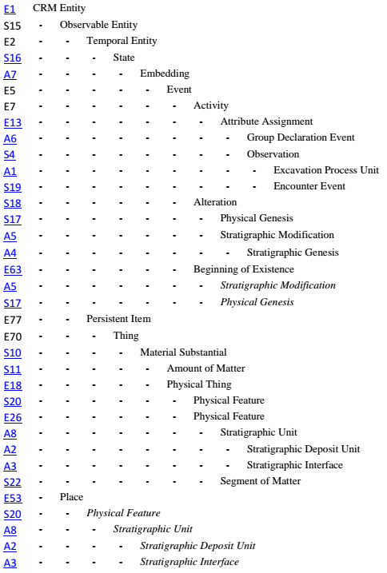
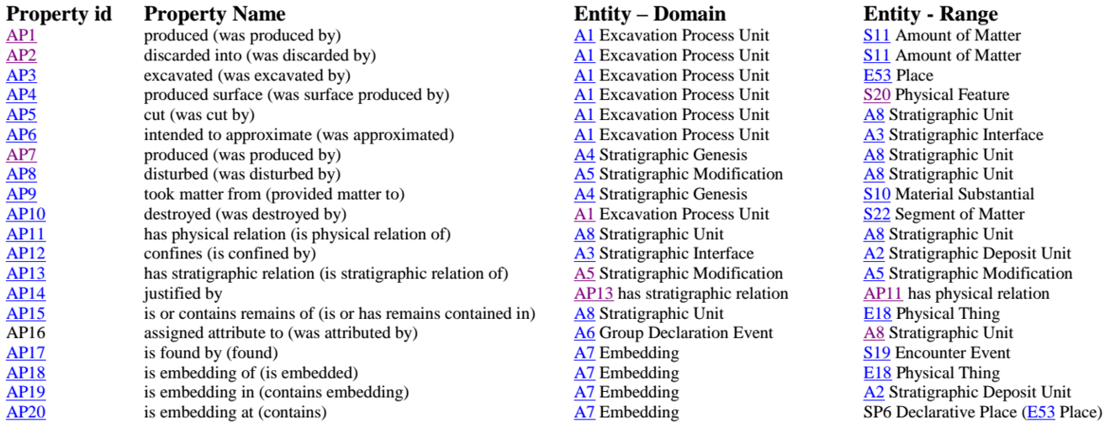
Excavation Model Class and Property Hierarchies
Notes:
Here (on the right) are the 8 Excavation model classes, in their hierarchical relationship to the CRM and CRMsci classes. So we see, for example, that A8 Stratigraphic Unit is a E26/S20 Physical Feature, which is a E18 Physical Thing, which is a S10 Material Substantial, which is a E70 Thing, which is a E77 Persistent Item, which is a S15 Observable Entity, which is a E1 CRM Entity.
[] Likewise, an A8 Stratigraphic Unit can be AP5 (property) ‘cut by’, an A3 Stratigraphic Interface.

