Slide 1
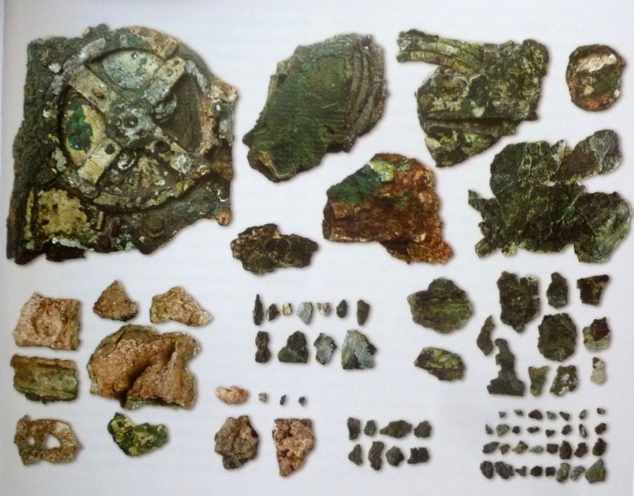
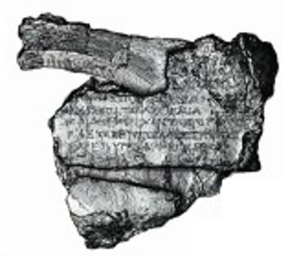
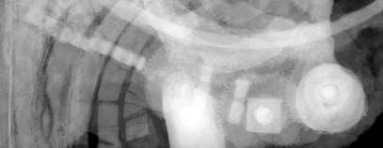
P190 has symbolic content
P129 is about
Using CRMtex and
text recognition activities
TX12 Grapheme Sequence
ΑΕΤΟΣ ΕΠΙΤΕΛΛΕΙ ΕΣΠΕΡΙΟΣ
E33 Linguistic Object
P72 has language
E62 String
Altair rises in the evening
“ΑΕΤΟΣ ΕΠΙΤΕΛΛΕΙ ΕΣΠΕΡΙΟΣ”
E56 Language
English
TXP15 recorded correspondence
P16 used specific object
TX5 Text Recognition
Recognizing a piece of text in one of the Antikythera mechanism parts
P46i forms part of
The Antikythera mechanism
P138 represents
TX1 Written Text
Computer x-ray tomography
TXP4 has segment
E36 Visual Item
TXP10 deciphered text
P134 continued
TX3 Writing System
E22 Human Made Object
TXP16i is employed by
The Greek alphabet
TX7 Written Text Segment
TX13 Script
TXP8 has component
TXP7i is item of
The Greek script
TXP10 deciphered text
TXP15 recorded correspondence
TX8 Grapheme
TX5 Text Recognition
E
P2 has type
TX9 Glyph
Recognizing a specific character in one of the Antikythera mechanism parts
TX11 Grapheme Occurrence
E, second character of sequence
physical
symbolic

Slide 2
Without text recognition activities
P46i forms part of
Computer x-ray tomography
P138 represents
The Antikythera mechanism parts
TX1 Written Text
E36 Visual Item
TXP4 has segment
E22 Human Made Object
“ΑΕΤΟΣ ΕΠΙΤΕΛΛΕΙ ΕΣΠΕΡΙΟΣ”
“Altair rises in the evening”
TX7 Written Text Segment
P128 carries
E34 Inscription
E33 Linguistic Object
P73 has translation
P72 has language
TXP8 has component
P106 is composed of
E56 Language
“E”
English
TX9 Glyph
P128 carries
E34 Inscription
physical
symbolic

Slide 4
CRMtex figures

Slide 5
E90 Symbolic Object
E65 Creation
E7 Activity
E89 Propositional Object
E55 Type
TXP17 has part
P94 has created
I1 Argumentation
TXP11 transcribed
TX6 Transliteration
TXP7 has item
TX8 Grapheme
TX12 Grapheme Sequence
S4 Observation
TX13 Script
P2 has type
TX11 Grapheme Occurrence
E25 Human-Made Feature
E24 Physical Human-Made Thing
E29 Design or Procedure
TXP15 recorded correspondence
TX4 Writing Field
TXP10 deciphered text
TX5 Text Recognition
P9 consists of
TX14 Reading
TX10 Style
E25 Human-Made Feature
TXP14 used copy or representation of
TXP18
read
TXP12 has style
TXP2 includes
P9 consists of
TX1 Written Text
TXP13 deciphered via the representation
P134
continued
TXP9 is encoded using
P138 represents
TXP4 has segment
E36 Visual Item
Ix1 Meaning Comprehension
E29 Design or Procedure
TX7 Written Text Segment
TXP8 has component
E12 Production
TXP16 employs
script
TX3 Writing System
TX9 Glyph
F28 Expression Creation
E56 Language
TXP5 wrote
TXP6 encodes
TXP1 used writing system
TX2 Writing
symbolic
physical
activities

Slide 6
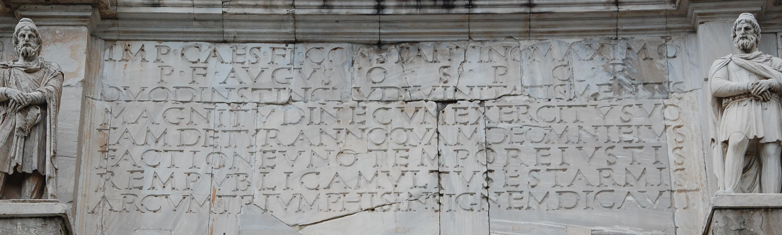
Scenario 1: Autoptic investigation only
TXP10 deciphered text
TX5 Text Recognition
TX1 Written Text
The ‘autoptic’ activity of recognizing the inscription text
physical
:textRecogn_ArchOfConstantine
rdf:type crmtex:TX5_Text_Recognition ;
crmtex:TXP10_deciphered_text :TX1_Written_Text_in_Arch .
:TX1_Written_Text_in_Arch
rdf:type crmtex:TX1_Written_Text .

Slide 7
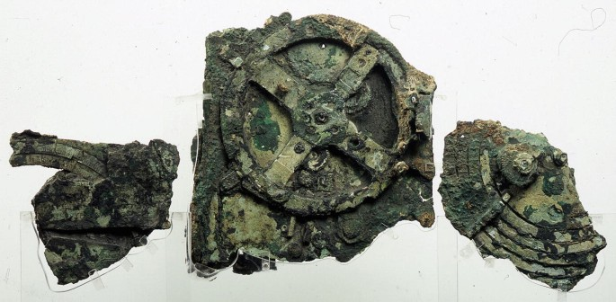
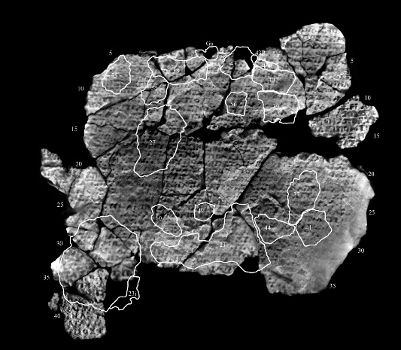
Scenario 2: Autoptic investigation + auxiliary material (e.g. a photo)
TXP10 deciphered text
TX5 Text Recognition
P16 used specific object
TX1 Written Text
The ‘autoptic’ activity of recognizing the inscription text
+ using auxiliary material
E73 Information Object
physical
Reported case: The Antikythera Mechanism, some 700 chars identified by additional BTI.
https://www.ellines.com/en/good-news/29656-oi-epigrafes-tou-michanismou-ton-antikuthiron/
http://www.antikythera-mechanism.gr/system/files/0608_Nature.pdf
:textRecogn_ArchOfConstantine
rdf:type crmtex:TX5_Text_Recognition ;
crmtex:TXP10_deciphered_text :TX1_Written_Text_in_Arch .
crm:P16_used_specific_object :E70_Thing_or_subclass_instance // e.g. E73 Information Object
:TX1_Written_Text_in_Arch
rdf:type crmtex:TX1_Written_Text .

Slide 8
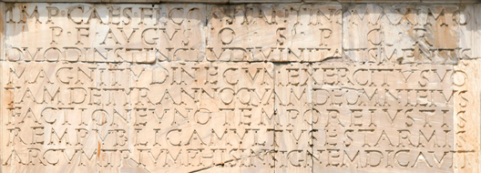
Scenario 3: Non-autoptic recognition, using a digital representation only (e.g., a photo, BTI imaging, ...)
TXP14 used copy or representation of
TX5 Text Recognition
TXP13 deciphered via the representation
TX1 Written Text
The ‘non-autoptic’ activity of recognizing the inscription text, using a digital representation
physical
E36 Visual Item
P138 represents
:textRecogn_ArchOfConstantine
rdf:type crmtex:TX5_Text_Recognition ;
crmtex:TXP13_deciphered_via_the_representation :E36_Visual_Item_Instance ;
crmtex:TXP14_used_copy_or_representation_of :TX1_Written_Text_in_Arch .
:E36_Visual_Item_Instance
rdf:type crm:E36_Visual_Item ;
crm:P138_represents :TX1_Written_Text_in_Arch .
:TX1_Written_Text_in_Arch
rdf:type crmtex:TX1_Written_Text .
FOL
TXP13(x, y) ⇒ (∃z) [TXP14(x, z) ∧ P138(y, z) ^ ¬TXP10(x, z)]

Slide 9
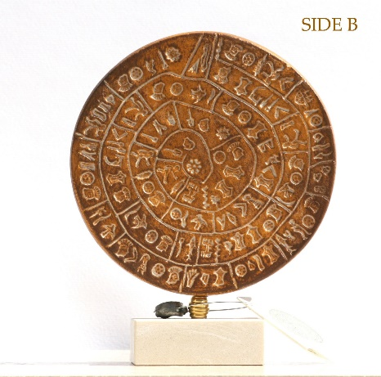
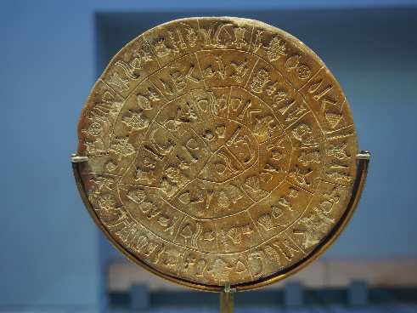
Scenario 4: Recognition using a copy / replica
(e.g. because the original is not available, or does not exist anymore)
TXP10 deciphered text
TX5 Text Recognition
TXP14 used copy or representation of
E24 Physical Human-Made Thing
The activity of recognizing the inscription text, using a copy of the original
TX1 Written Text
replica
original
P130 shows features of
:textRecogn_in_phaistosDisc
rdf:type crmtex:TX5_Text_Recognition ;
crmtex:TXP10_deciphered_text :E24_Copy_of_PhaistosDisc
crmtex:TXP14_used_copy_or_representation_of :TX1_Original_PhaistosDisc .
:TX1_Original_PhaistosDisc
rdf:type crmtex:TX1_Written_Text .
:E24_Copy_of_PhaistosDisc
rdf:type crm:E24_Physical_Human-Made_Thing ;
crm:P130_shows_features_of :TX1_Original_PhaistosDisc .
FOL:
TXP10(x, z1) ∧ TPX14(x, z2) ⇒ P130(z1, z2)

