Slide 1

Prototype on illuminated manuscripts and future steps for metadata integration
Nürnberg 19 May 2015 - Stefanie Gehrke - Metadata Coodinator Biblissima
Notes:
I‘d like to welcome you to this presentation about …

Slide 2
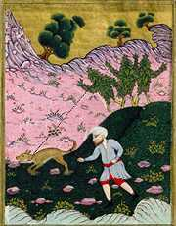

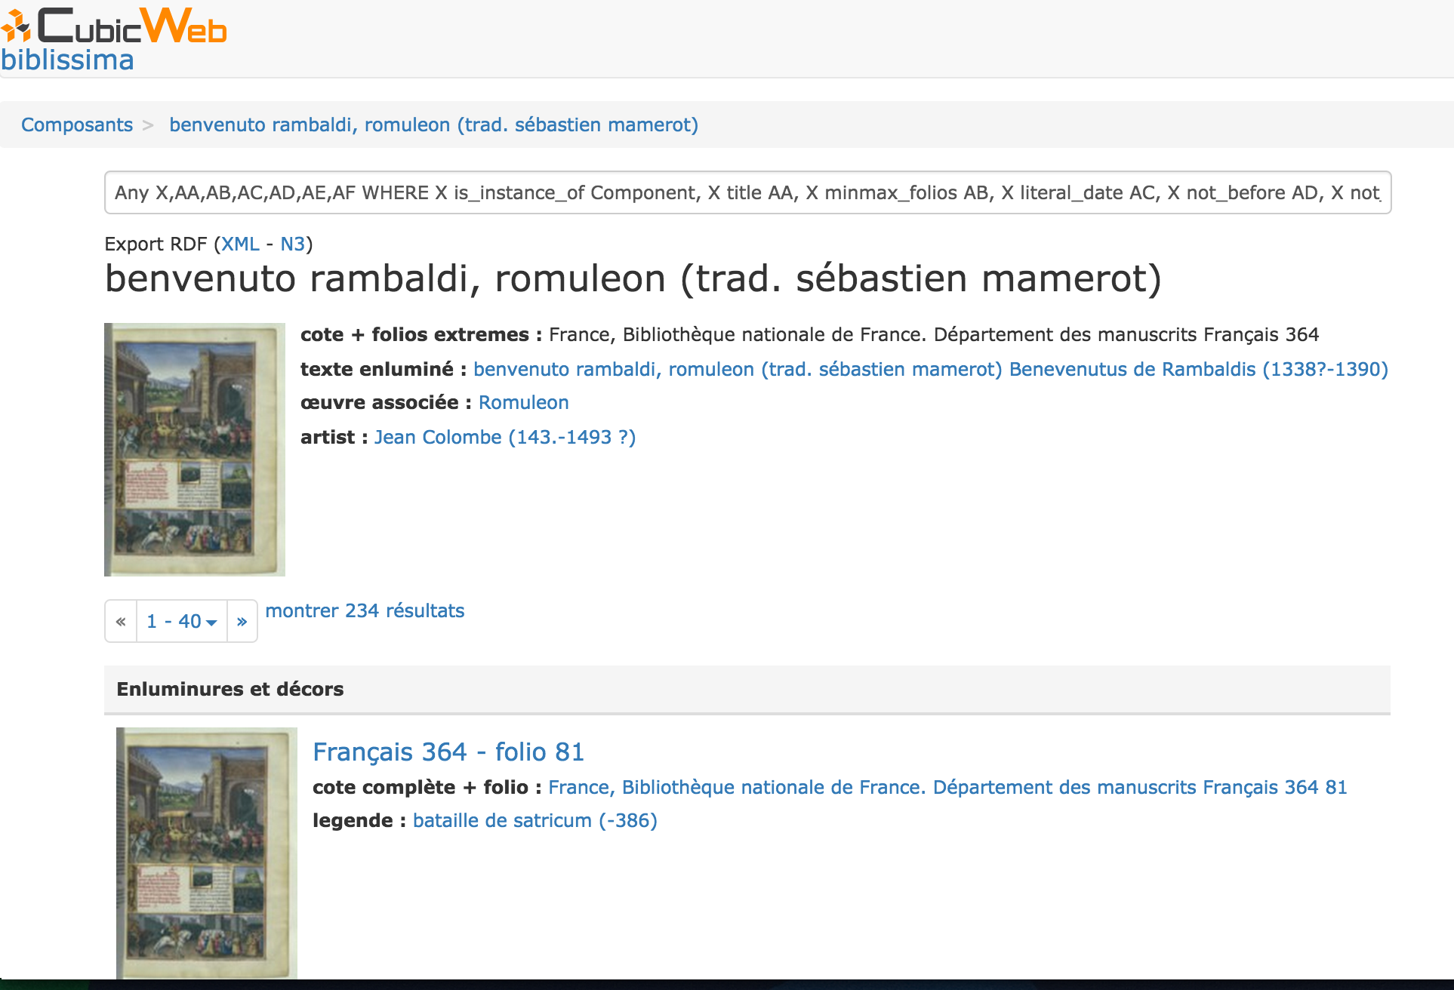


(Mandragore)
Nürnberg 19 May 2015 - Stefanie Gehrke - Metadata Coodinator Biblissima
Notes:
The biblissima prototype is about the federation of two iconographic databases into one access point

Slide 3
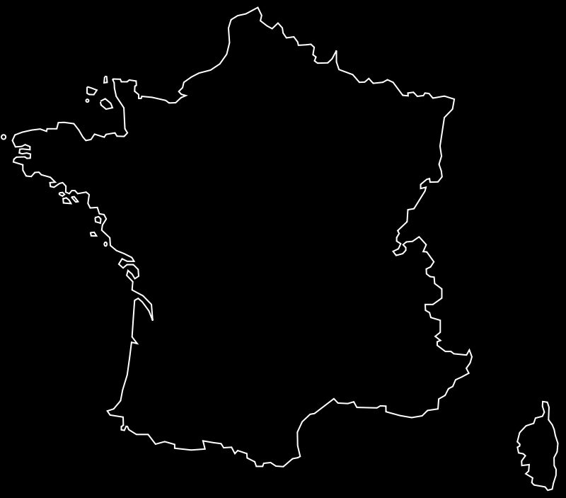









Biblissima Consortium
70% Data Creation
30% Portal
Notes:
First let me introduce the Biblissima consortium: … 9 partners, …

Slide 4


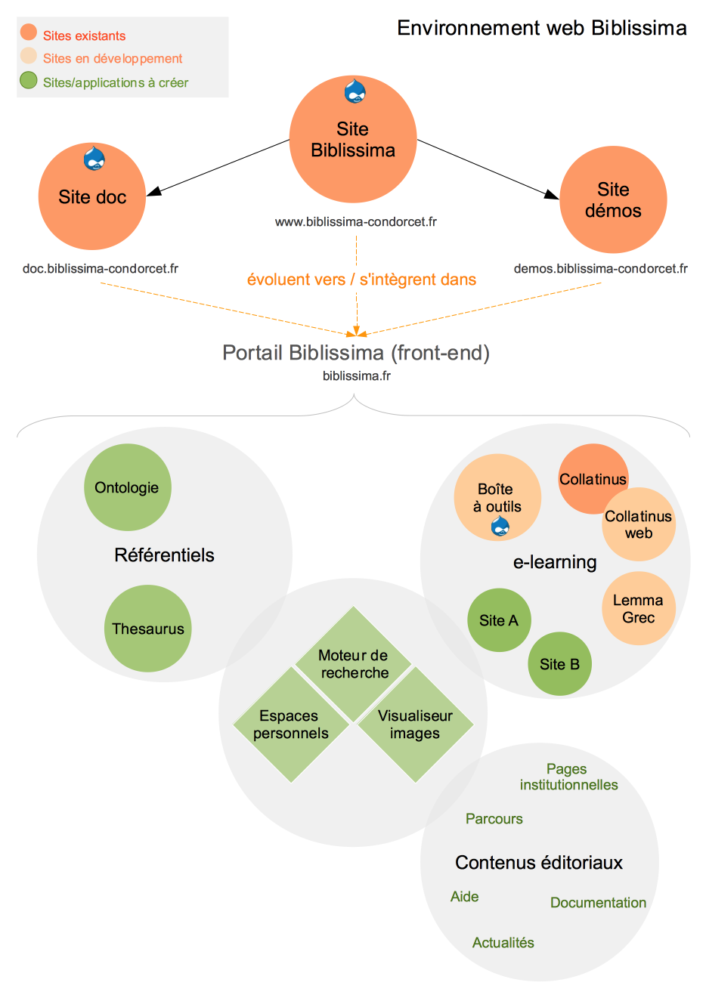



Biblissima Portal
Notes:
One objective of biblissima is the creation of a portal. The slide shows the major components of this portal. …

Slide 5
PROTOTYPE
- PostgreSQL
- Python
- RQL
- Virtuoso
- Used by data.bnf.fr bp16.bnf.fr reliures.bnf.fr
www.fevis.fr andrebreton.fr www.transdev-idf.com
Notes:
At the present time a prototype exists and is under further development, … The prototype is built on the CubicWeb engine by Logilab… a semantic web application.

Slide 6
PROTOTYPE
Autority files
in collaboration with IRHT, Caen etc.
2000 manuscripts kept by 60 different institutions
Components (textual or artistic)
Grouping
Text
Associated Work
20 000 Illuminations
Descriptors
Captions
Artists
Localisation
150 identified works
Expression
Manifestation Singleton
Notes:
The prototype is not only a technology demo but we already filled it with data from our partners. …

Slide 7

PROTOTYPE
Exposure in RDF
CIDOC-CRM et FRBRoo compliant
Reuse of data.bnf.fr URIs
record linkage : VIAF, GeoNames
Definition of import format in XML
Thesaurus Biblissima
Vocabularies technical terms
Schema PostgreSQL
Spatial data
GINCO
Notes:
The data behind the prototype is RDF based, …

Slide 8
Exposure in RDF
<!-- 1. Manuscript Metadata Part A -->
<rdf:Description rdf:about=“/id/Manuscript/{Base}/{idManuscript}">
<rdf:type rdf:resource="bibma:Manuscript"/> Subclass of efrbroo:F4_Manifestation_Singleton <rdfs:label><!– manuscript name goes here --></rdfs:label>
<ecrm:P48_has_preferred_identifier rdf:resource=“/id/Shelfmark/{Base}/{idManuscript}”/> bibma:Shelfmark <ecrm:P50_has_current_keeper rdf:resource=”#foaf:Organization”/> ecrm:E40_Legal_Body <efrbroo:R31i_has_reproduction rdf:resource="http://bvmm.irht.cnrs.fr/consult/consult.php?reproductionId=7725"/> bibma:Digital_Surrogate
<ecrm:P70i_is_documented_in rdf:resource=”EADC:D35A11035"/> ecrm:E31_Document;bibma:Record <ecrm:P46_is_composed_of rdf:resource=“/id/Component/{Base}/{idManuscript}/{idComponent}"/>
bibma:Component
<ecrm:P46i_forms_part_of><!– URI group goes here, if manuscript is a member of a group --> </ecrm:P46i_forms_part_of> bibma:Manuscript
Notes:
Let‘s have a more detailed look at the RDF data,…

Slide 9
Exposure in RDF
<!– 1. Manuscript Metadata Part B -->
<ecrm:P43_has_dimension> bibma:has_extent ? <ecrm:E54_Dimensions> bibma:Extent ? <ecrm:P90_has_value><!-- number of folios goes here --></ecrm:P90_has_value>
<ecrm:P91_has_unit>f.</ecrm:P91_has_unit>
</ecrm:E54_Dimensions>
</ecrm:P43_has_dimension>
<ecrm:P43_has_dimension> bibma:has_format ? <ecrm:E54_Dimensions> bibma:Format ? <ecrm:P90_has_value><!-- height and width goes here --></ecrm:P90_has_value>
<ecrm:P91_has_unit>mm</ecrm:P91_has_unit>
</ecrm:E54_Dimensions> </ecrm:P43_has_dimension>
</rdf:Description>
Notes:
Here is another example, showing ….
Looking forward to the teaching session tomorrow morning , looking forward to learn more about how to create an extension

Slide 10
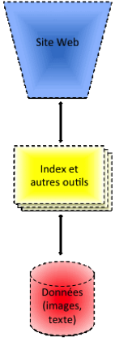
The « Cluster »
11
Catalogues Repositories
3
Digital Libraries
30+
Specialised Data Bases
8
Corpora of Electronic Editions
Notes:
What have we achieved so far? We build a prototype that gives access to …

Slide 11
Next Steps - Data Integration
former owner / former shelfmarks
other features (provenance marks)
inventories and sales catalogues
digital editions
integration of incunabulas
Notes:
Having built the foundation, the next steps in data integration are (could be)…
is a copy ot

Slide 12
Next Steps - Access Point Data
more data
integration of roles and related objects in the pages of persons
integration of related expressions and manuscripts in the pages of works
focus on expressions
Notes:
From the perspective of Access Point data, the next steps are, …

Slide 13
Live Demo
Rome (Italie)
titus livius, ab urbe condita
Présentation du livre
descriptions des côtes et îles de la méditerranée
Saint-Denis (Seine-Saint-Denis, France)
Notes:
Finally I‘d like To give you an impression of the prototype by doing a live demo.
deadlock

Slide 14
MERCI
Pauline Charbonnier
Eduard Frunzeanu
Marie Muffat
Doudou Dieye
Régis Robineau (frames Mirador)
Adrien di Mascio Logilab
Nürnberg 19 May 2015 - Stefanie Gehrke – contact : stefanie.gehrke@biblissima-condorcet.fr

