Slide 1
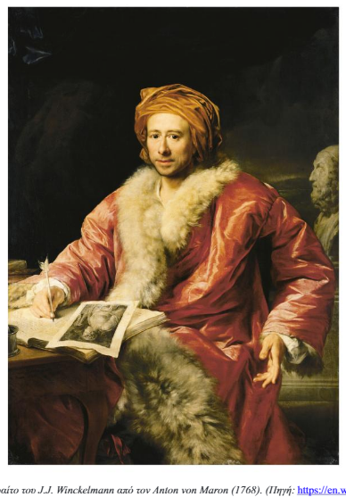
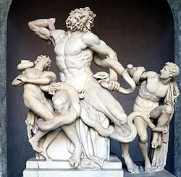
E52 Time-Span
E52 Time-Span
E73 Information Object (E28)
1764
1768
E53 Place
“History of the Art in Antiquity”
P7 took place at
Trieste
P4 has time-span
P4 has time-span
P67 refers to
P94 has created (P92)
E69 Death (E64)
E65 Creation (E63)
Winckelmann’s death
Winckelmann writes “History of the Art in Antiquity”
P100 was death of (P93)
E52 Time-Span
1755
P14 carried out by (P12)
E22 Human-Made Object (E18)
P4 has time-span
ρρδγφγγγγγγγγγγγ
E5 Event
E21 Person (E39)
Laocoön Group
P12 occurred in the
presence of
Winckelmann sees “Laocoön”
P12 occurred in the
presence of
Johann-Joachim Winckelmann
E53 Place
P98 brought into life (P92)
P2 has type
Vatican, Rome
P7 took place at
Vatican, Rome
E67 Birth (E63)
E21 Person (E39)
E55 Type
P96 by mother (P12)
P108 has produced (P92)
Winckelmann’s birth
Anna-Maria Meyer
Copy
E22 Human-Made Object (E18)
E12 Production (E63)
Roman-commissioned copy of the Laocoön Group
P12 occurred in the
presence of
P4 has time-span
P7 took place at
Laocoön Group
E53 Place
E52 Time-Span
Stendal
E55 Type
P2 has type
1717
Hellenistic

